Slide 1
Project X
CS 512
Instructor: James Abello < abello@dimacs.rutgers.edu >
TAs: Cuong Trang and Meng Lee

Slide 2
Presentation Outline
Purpose/Goal
Description : Pictures are essential
A Flow Diagram of your project main components is essential.
An Interface snapshot indicating users interaction with your final product.
Project Stumbling Blocks
Data collection
Conceptual Diagram
Algorithmic Infrastructure
Implementation
Sample of findings
Future Extensions/Work
References/Resources used (libraries, languages, web resources)
Acknowledgements

Slide 3
Purpose
Become exposed to the main steps required to design an algorithm based project from data collection up to a minimalistic, ordered and user-friendly interface.
To implement a prototype and apply it to a data domain of your choice.
To justify your design and implementation choices
To demonstrate a sample of your algorithmic findings
To explore other useful algorithmic primitives for data exploration beyond the chosen ones.
To give a presentation and complete a latex report of your project.

Slide 4
Project Description
Explain the different data entities that your project will handle(for example: a medical system, a school system, a hotel system, …etc).
Insert here your conceptual project design (i.e. build your application flow diagram). Explain it in a manner that brings to the surface a proper implementation.
Discuss how your group built the implementation of your application
Present your interface and justify how it allows good data access and presentation.

Slide 5
Data Collection
Describe how the data was collected.
Specify four types of users, differentiated by their algorithmic knowledge ( naïve, student, professional, teacher, researcher).
Describe two real world scenarios representing the interactions between each user type and your application system (including inputs and outputs).

Slide 6
Conceptual Diagram
Determine the different entities in your application.
Determine the relationships among your entities.
Lay out in a diagram the entities and their relationships.
Provide justifications for your conceptual diagram.

Slide 7
Implementation
Create your data views.
Upload the data.
Query the different data elements in order to get “meaningful” answers to your group desired information needs.
Suggest possible algorithms to “mine” the collected data.

Slide 8
Interface Integration
Build an interface to your visual representation.
Determine appropriate error messages for the user updates/access, and data range violations.

Slide 9
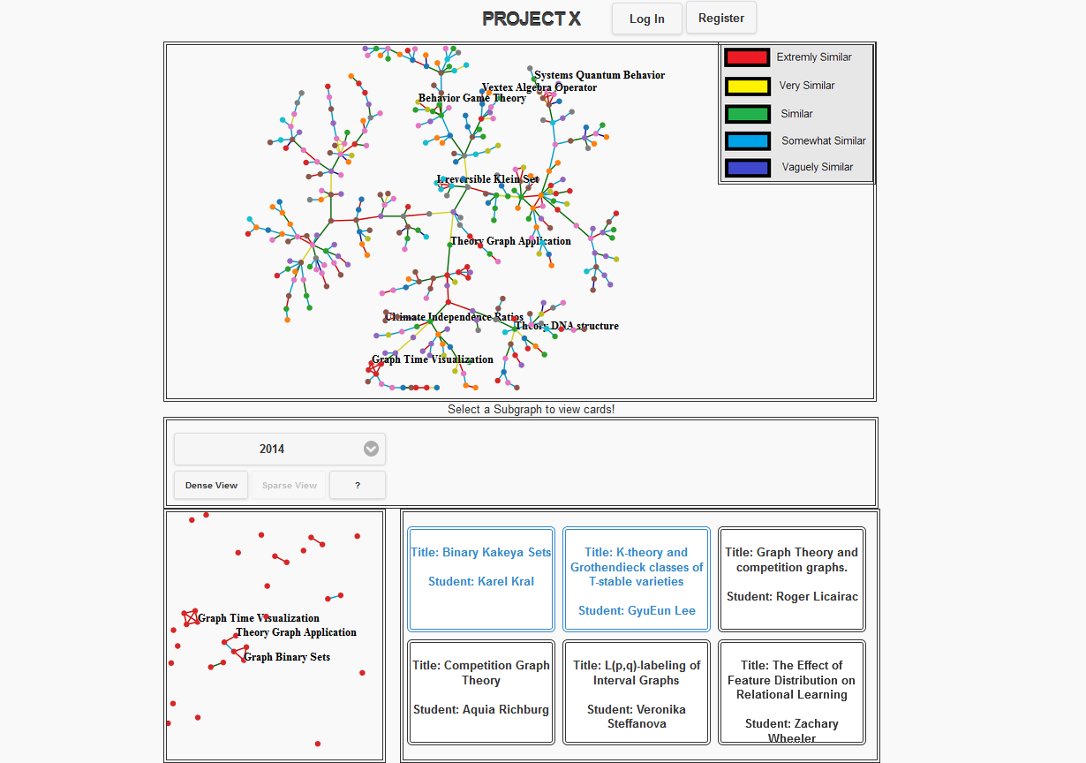
Sample View of a possible Interface

Slide 10
Sample of Findings
As time went by, the project data started to become more meaningful while being queried in a certain way. Those more meaningful queries were expanded to mine the data. These queries lead us to find the following interesting results in our data domain.
< Insert here your sample of interesting results >
The possibility of implementing the following queries can lead to other results that will enhance the usefulness of the collected data.
< Insert here those potential queries that could enhance the usefulness of your dbms >.

Slide 11
Future Work
The project could be expanded by determining other class projects that will benefit from our group work. They are :
Adding the following system mechanisms will improve efficient data access. They are :
The following data views will enhance our application usefulness. They are:
We would eventually like for our project to become blah, blah where users can interact differently (by doing so and so), in order to achieve better and broader usage goals (like so and so).

Slide 12
References:
Resources:
jQuery

Slide 13
Acknowledgements
We would like to thank the following programs/persons for their help and support.

